Slide 1
HIPAA
Department of Health Care Services
(DHCS)

Slide 2
Introduction
HIPPA stands for Health Insurance Portability and Accountability Act.
passed by Congress in 1996.
HIPPA does the following:
Provides the ability to transfer and continue health insurance coverage for millions of American workers and their families when they change or lose their jobs.
Reduces health care fraud and abuse.
Mandates industry-wide standards for health care information on electronic billing and other processes.
Requires the protection and confidential handling of protected health information

Slide 3


Introduction

Slide 4
Rules
The Privacy Rule, which sets national standards for when protected health information (PHI) may be used and disclosed
The Security Rule, which specifies safeguards that covered entities and their business associates must implement to protect the confidentiality, integrity, and availability of electronic protected health information (ePHI)
The Breach Notification Rule, which requires covered entities to notify affected individuals, U.S. Department of Health & Human Services (HHS), and in some cases, the media of a breach of unsecured PHI

Slide 5
Rules (Examples)
Do not discuss patient's care with anyone not directly involved.
Do not discuss patient details with family, friends, etc.
Do not talk about patient in public areas.
Do not read patients' charts when you are not involved in their care.

Slide 6
The HIPAA Compliance Audit Program
In 2011, the Office for Civil Rights (OCR) started checking whether hospitals and healthcare companies were actually following HIPAA rules. These checks were called pilot audits.
By 2012, during the first full round of these audits, OCR found many problems:
Organizations were not informing patients properly when a data breach happened (Breach Notification Rule violations).
They were not protecting patient privacy correctly (Privacy Rule violations).
And the biggest issue: they were not securing patient data well (Security Rule violations).
Overall, the audits showed that healthcare providers in the U.S. were not doing a good job of following HIPAA requirements at that time.

Slide 7
The HIPAA Privacy Rule
What is the HIPAA Privacy Rule?
What is PHI?
Use and Disclosure of PHI
Marketing and Fundraising Protocols
Patient Access to Medical Records
Notice of Privacy Practices
NOTE: The HIPAA Privacy Rule applies to PHI in any form. This includes computer and paper files, x-rays, physician appointment schedules, medical bills, dictated notes, conversations, and information entered into patient portals.

Slide 8
HIPAA regulations list eighteen different personal identifiers (PHI):
Names
All geographical data smaller than a state
Dates (other than year) directly related to an individual
Telephone numbers
Fax numbers
Email addresses
Social Security numbers
Medical record numbers
Health insurance plan beneficiary numbers
Account numbers

Slide 9
Eighteen personal identifiers are:
Certificate/license numbers
Vehicle identifiers and serial numbers including license plates
Device identifiers and serial numbers
Web URLs
Internet protocol (IP) addresses
Biometric identifiers (i.e. retinal scan, fingerprints, Etc.)
Full face photos and comparable images
Any unique identifying number, characteristic or code

Slide 10
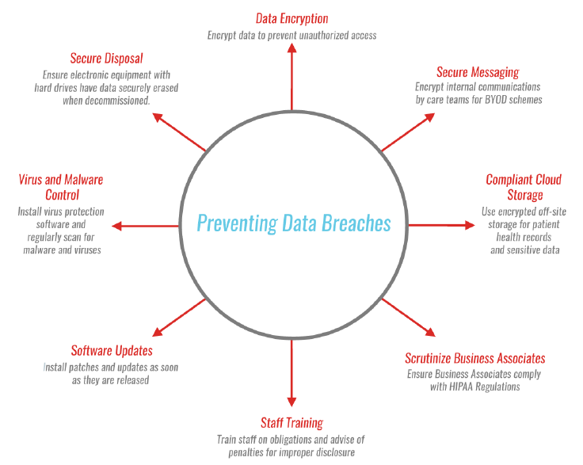
Notice of Privacy Practices
An example of a Notice of Privacy Practices can be found on the OCR´s website

Slide 11
The HIPAA Security Rule
What is the HIPAA Security Rule?
What is the Difference between PHI and ePHI?
Technical Safeguards
Physical Safeguards
Administrative Safeguards
Policies, Sanctions and Training
Contingency and Disaster Recovery Plans
Risk Analysis and Risk Management

Slide 12
What are the HIPAA Requirements for a Website?
Transport Encryption: Data must be encrypted if it is transmitted over the Internet
Backup: Data cannot be lost, I.e. it should be backed up and must be recoverable
Authorization: Data can only be accessible by authorized personnel using unique, audited access controls
Integrity: Data cannot be tampered with or altered
Storage Encryption: Data should be encrypted when it is stored or archived
Disposal: Data must be permanently erased when it is no longer needed
Sharing: If data is located on the web servers of a third party, that entity must agree to comply with HIPAA regulations and a HIPAA Business Associate Agreement must be in place

Slide 13
How Does a Simple Website Stack up Against These Requirements?
By a simple website, we refer to one set with any of the popular hosting providers (e.g. GoDaddy) and written using off the shelf software or by someone without training in HIPAA website security best practices:
Transport Encryption – Fail
Backups – Uncertain
Authorization – Uncertain
Integrity – Fail
Storage Encryption – Fail
Disposal – Uncertain
Business Associates – Fail

Slide 14
oTHER SECURITY CONCERNS
IT Network Security
Text Messages and Replacing Pagers

